Slide 1
AgroCare: Plant Disease Detection & Crop Recommendation System
Under the Guidance
of
Prof. (Dr.) S. S. Thakur
Professor, Dept. of CSE
Presented by:
Upayan Chakraborty (11600222134)
Prerana Maiti (11600222070)
Mrigangana Sarkar (11600222062)
Sandipan Rakshit (11600222092)
Souvik Ghosh (11600222117)

Slide 2
Acknowledgement
We sincerely thank everyone who contributed to our ongoing project, "AgroCare: Plant disease detection & Crop Recommendation System".
Our deepest gratitude goes to our guide, Prof. Dr. S. S. Thakur, for his invaluable guidance and support. We also extend heartfelt thanks to Mr. Avijit Bose and Mr. Sumit Majumdar for their continuous support and facilitating our research.
We are grateful to all faculty members of the CSE Department at MCKV Institute of Engineering for their assistance and resources.
We are greatly indebted to Mr. Arijit Sen for his guidance and assistance in the hardware section of our project.
We are grateful to our peers for their feedback and collaboration.
Finally, we deeply appreciate the unwavering support, patience, and motivation from our friends and families.

Slide 3
Contents
Introduction
Crop Recommendation System Workflow
OpenWeatherMap API Integration
Software Output
Hardware Integration
Circuit Diagram
Hardware Output
Roadmap of Future Work

Slide 4
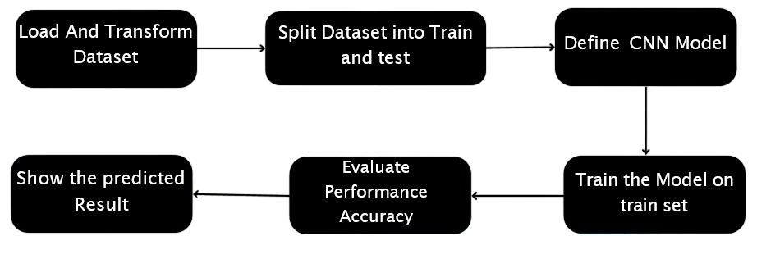
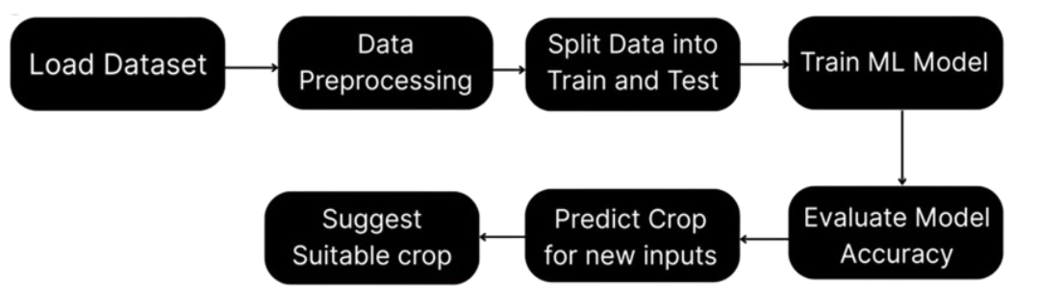
Introduction
Plant Disease Detection
Crop Recommendation System ​

Slide 5
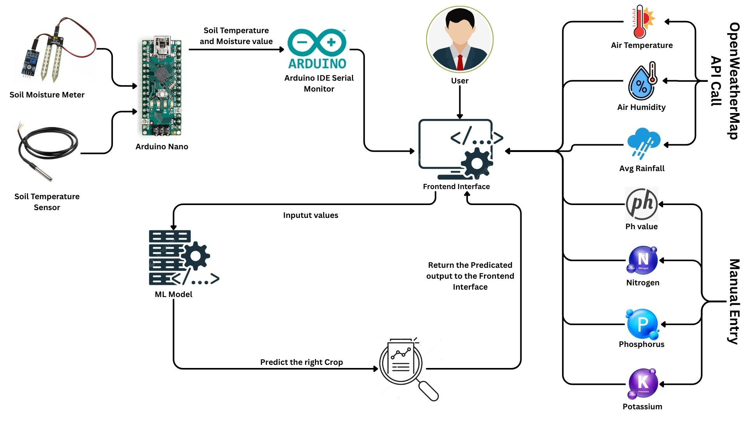
Workflow

Slide 6
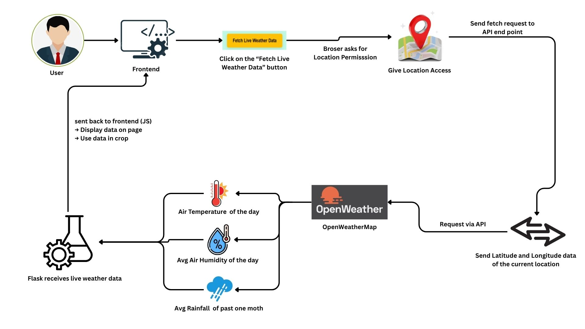
OpenWeatherMap API Integration

Slide 7
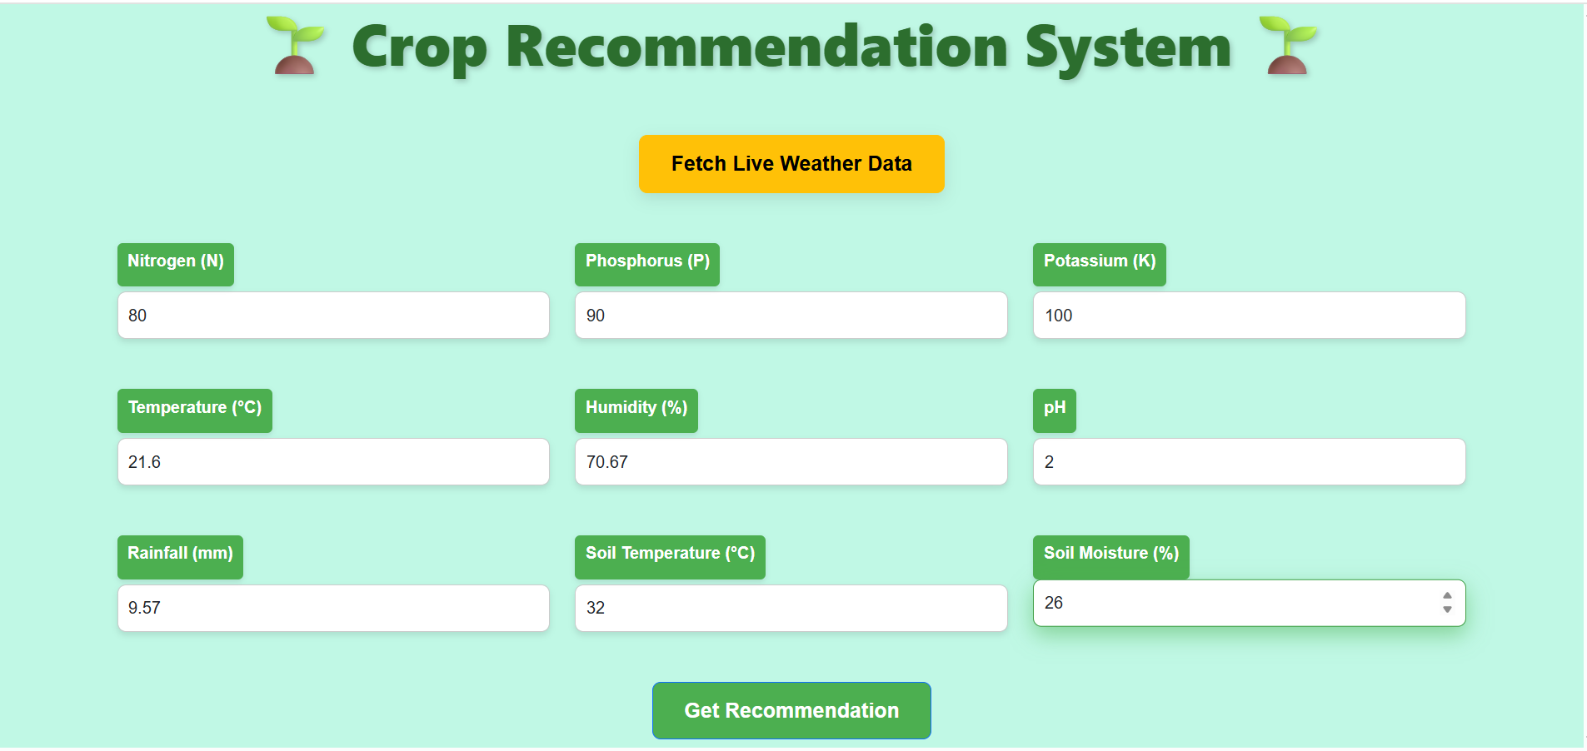

Software Output
Updated Crop Recommendation System form with sample values filled in, ready for processing and crop prediction. Live weather data fetched after clicking “Fetch Live Weather Data" button using OpenWeatherMap APIs.​
Output section of the Crop Recommendation System showing the predicted best crop (Banana) based on the input soil and environmental parameters.​

Slide 8
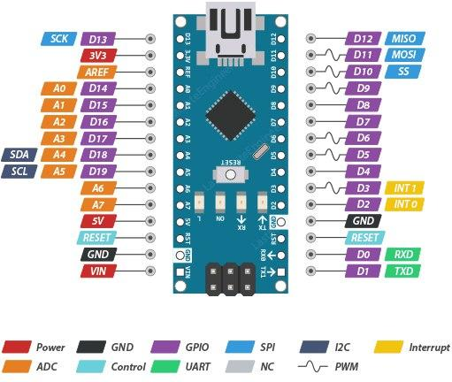
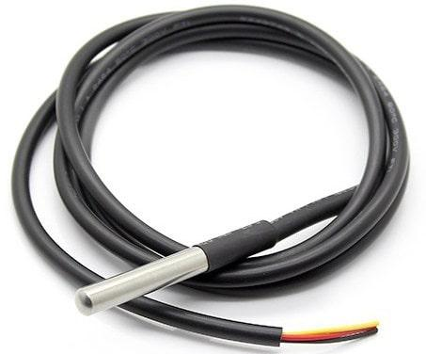
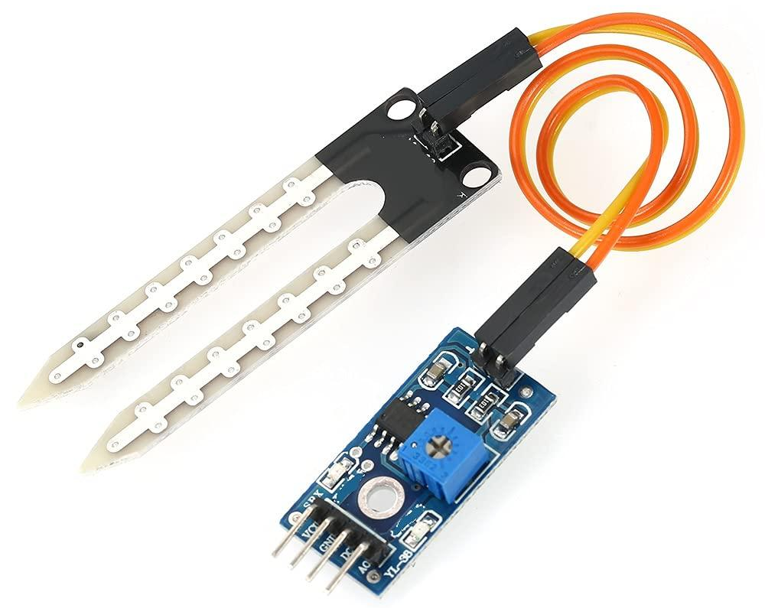
Hardware Integration
Arduino Nano
Soil Moisture Sensor
DS18B20Temperature Sensor
Based on the ATmega328P microcontroller
Provides 14 digital I/O pins and 8 analog inputs
Includes USB connectivity
Suitable for small-scale embedded and IoT projects
Measures soil water content (wet or dry)
Works by detecting changes in electrical resistance or capacitance
Ensures the optimal soil conditions for crop growth
Temperature readings from –55°C to +125°C
Uses a 1-Wire protocol by allowing multiple sensors to connect through a single data pin
Ideal for Soil temperature monitoring

Slide 9
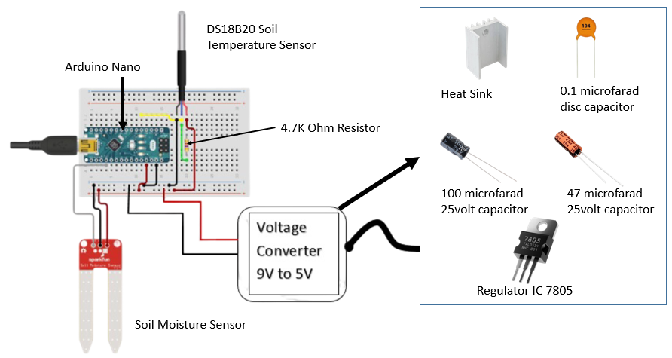
Circuit Diagram

Slide 10
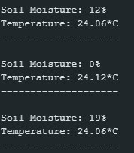
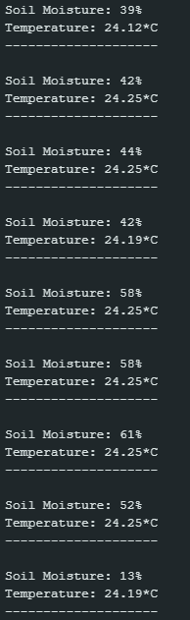

Hardware Output
A few snippets from the Serial Monitor showing the output after testing the setup on a Tulsi plant at home.​
Variation in Soil Moisture as water is being added
Variation in Temperature as dry soil is being moisturized

Slide 11
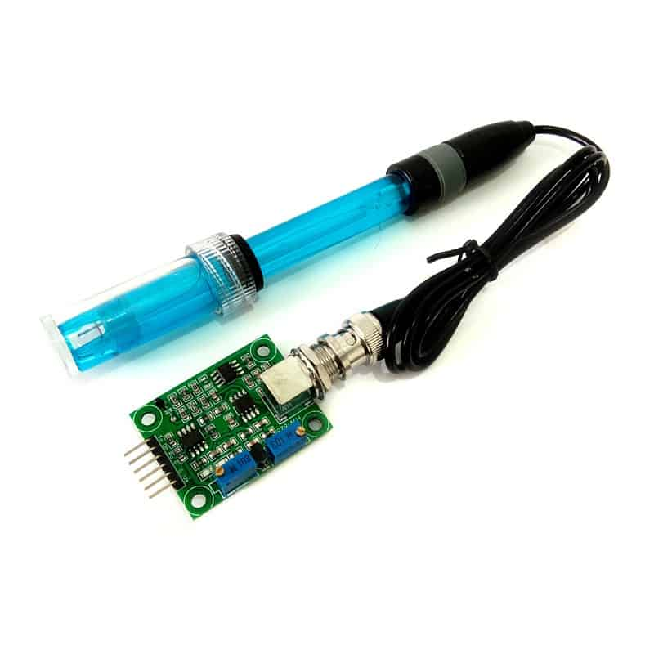
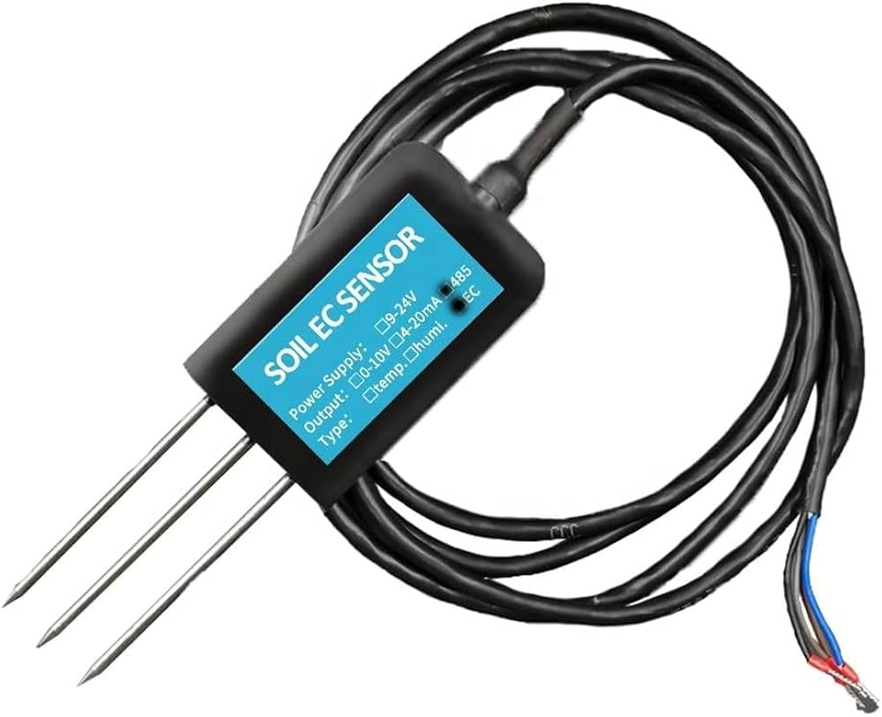
Roadmap of the Future Work
Proposed Work for 8th semester
1. Integration of PH sensor and NPK sensor
Integrate pH and NPK sensors with the existing setup
Retrieve real-time soil data directly through sensors
Auto-process these values to predict the best crops accurately
Remove the need for manual input of soil parameters
2. LLM Chatbot Integration for Better Efficiency
Integrate an LLM-powered chatbot into the app
Help farmers quickly search for crop-related information
Make the app more user-friendly and functional
Provide accurate and precise guidance to save farmers’ time and effort
pH sensor
NPK Sensor

Slide 12
Thank You

